Slide 1


KS4 Mathematics
D3 Scatter Graphs

Slide 2

Scatter graphs
What does this scatter graph show about the relationship between the height and weight of twenty Year 10 boys?
60
55
Weight (kg)
50
45
40
140
150
160
170
180
190
Height (cm)
As height increases, weight increases.
This is called a positive correlation.

Slide 3
Scatter graphs
What does this scatter graph show?
85
80
75
Life expectancy
70
65
60
55
50
0
20
40
60
80
100
120
Number of cigarettes smoked in a week
It shows that life expectancy decreases as the number of cigarettes smoked increases.
This is called a negative correlation.
Notes:
This data is fictional. However, there is a variety of research linking smoking to a number of fatal diseases such as cancer. For further details, see the ASH website (www.ash.co.uk).

Slide 4

Interpreting scatter graphs
Scatter graphs can show a relationship between two variables.
This relationship is called correlation.
Correlation is a general trend. Some data items will not fit this trend, as there are often exceptions to a rule. They are called outliers.
Scatter graphs can show:
positive correlation: as one variable increases, so does the other variable
negative correlation: as one variable increases, the other variable decreases
zero correlation: no linear relationship between the variables.
Correlation can be weak or strong.
Notes:
Stress that when there in no correlation between the variables it does not necessarily mean that there is no relationship, only that there is no linear relationship between them.

Slide 5
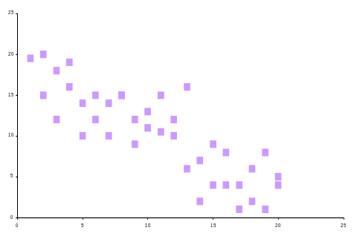
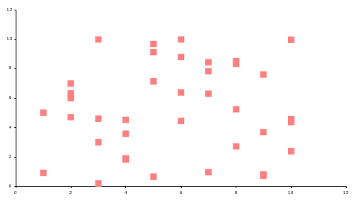
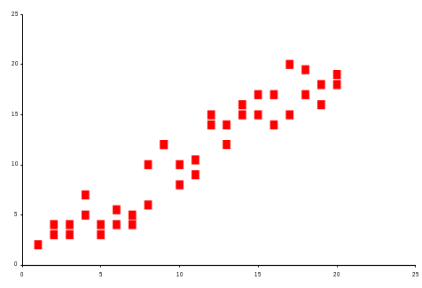
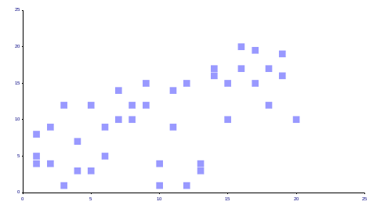
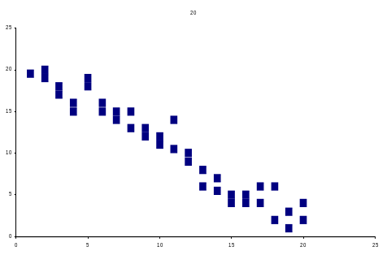
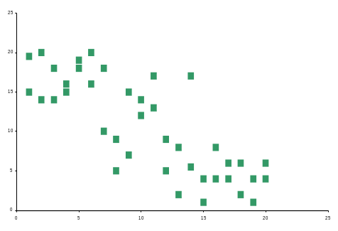
Identifying correlation from scatter graphs
Decide whether each of the following graphs shows,
A
B
strong positive correlation
strong negative correlation
zero correlation
weak positive correlation
weak negative correlation.
C
D
E
F

Slide 6
The line of best fit
The line of best fit is drawn by eye so that there are roughly an equal number of points below and above the line.
Look at these examples,
25
25
20
20
15
15
10
10
5
5
0
0
5
10
15
20
25
0
0
5
10
15
20
25
Strong positive correlation
Weak positive correlation
Strong negative correlation
Weak negative correlation
Notice that the stronger the correlation, the closer the points are to the line.
If the gradient is positive, the correlation is positive and if the gradient is negative, then the correlation is also negative.

Slide 7
Line of best fit
When drawing the line of best fit remember the following points,
The line does not have to pass through the origin.
For an accurate line of best fit, find the mean for each variable. This forms a coordinate, which can be plotted. The line of best fit should pass through this point.
The line of best fit can be used to predict one variable from another.
It should not be used for predictions outside the range of data used.
The equation of the line of best fit can be found using the gradient and intercept.

Slide 8

The line of best fit
This graph shows the relationship between life expectancy and the number of cigarettes smoked in a week.
85
80
75
Life expectancy
70
65
60
55
50
0
20
40
60
80
100
Number of cigarettes smoked in a week
Notes:
Pupils would benefit from a print out of the graph. The approximate equation of the line is y = -0.2x + 73. Note that the gradient is roughly (73 – 53) /100 not 73/100.

Slide 9
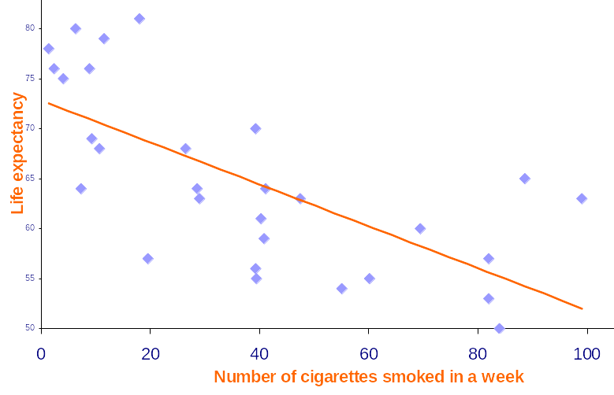
Solving problems with lines of best fit
Work out an estimate for the equation of the line of best fit using the gradient and intercept.
Use the equation to estimate the life expectancy for someone who smokes 10 cigarettes a day.
Why would an estimate of the number of cigarettes smoked for a life expectancy of 40 years not be reliable?
Can you explain why there are so many outliers for this data?

Slide 10
Cause and effect
A study finds a positive correlation between the number of cars in a town and the number of babies born.
The local newspaper reports,
“Buying a new car can help you get pregnant!”
Does the study support this conclusion?
Correlation does not necessarily imply that there is a causal relationship between the two variables. There may be some other cause.
What might this be in the example above?
Notes:
The greater the number of cars, the greater the population and so the greater the number of relationships which then causes the number of pregnancies to increase. Alternatively, families increasing in size could cause people to purchase another car, for example so both parents have transport.

Slide 11

Cause and effect
A study finds a negative correlation between the number of sledges sold and the temperature.
The local newspaper reports,
“If you want it to snow, go out and buy a sledge!”
Does the study support this conclusion?
Explain.
Notes:
The mistake here is to reverse the causal relationship. The drop in temperature causes snow which then causes people to buy sledges.

Slide 12
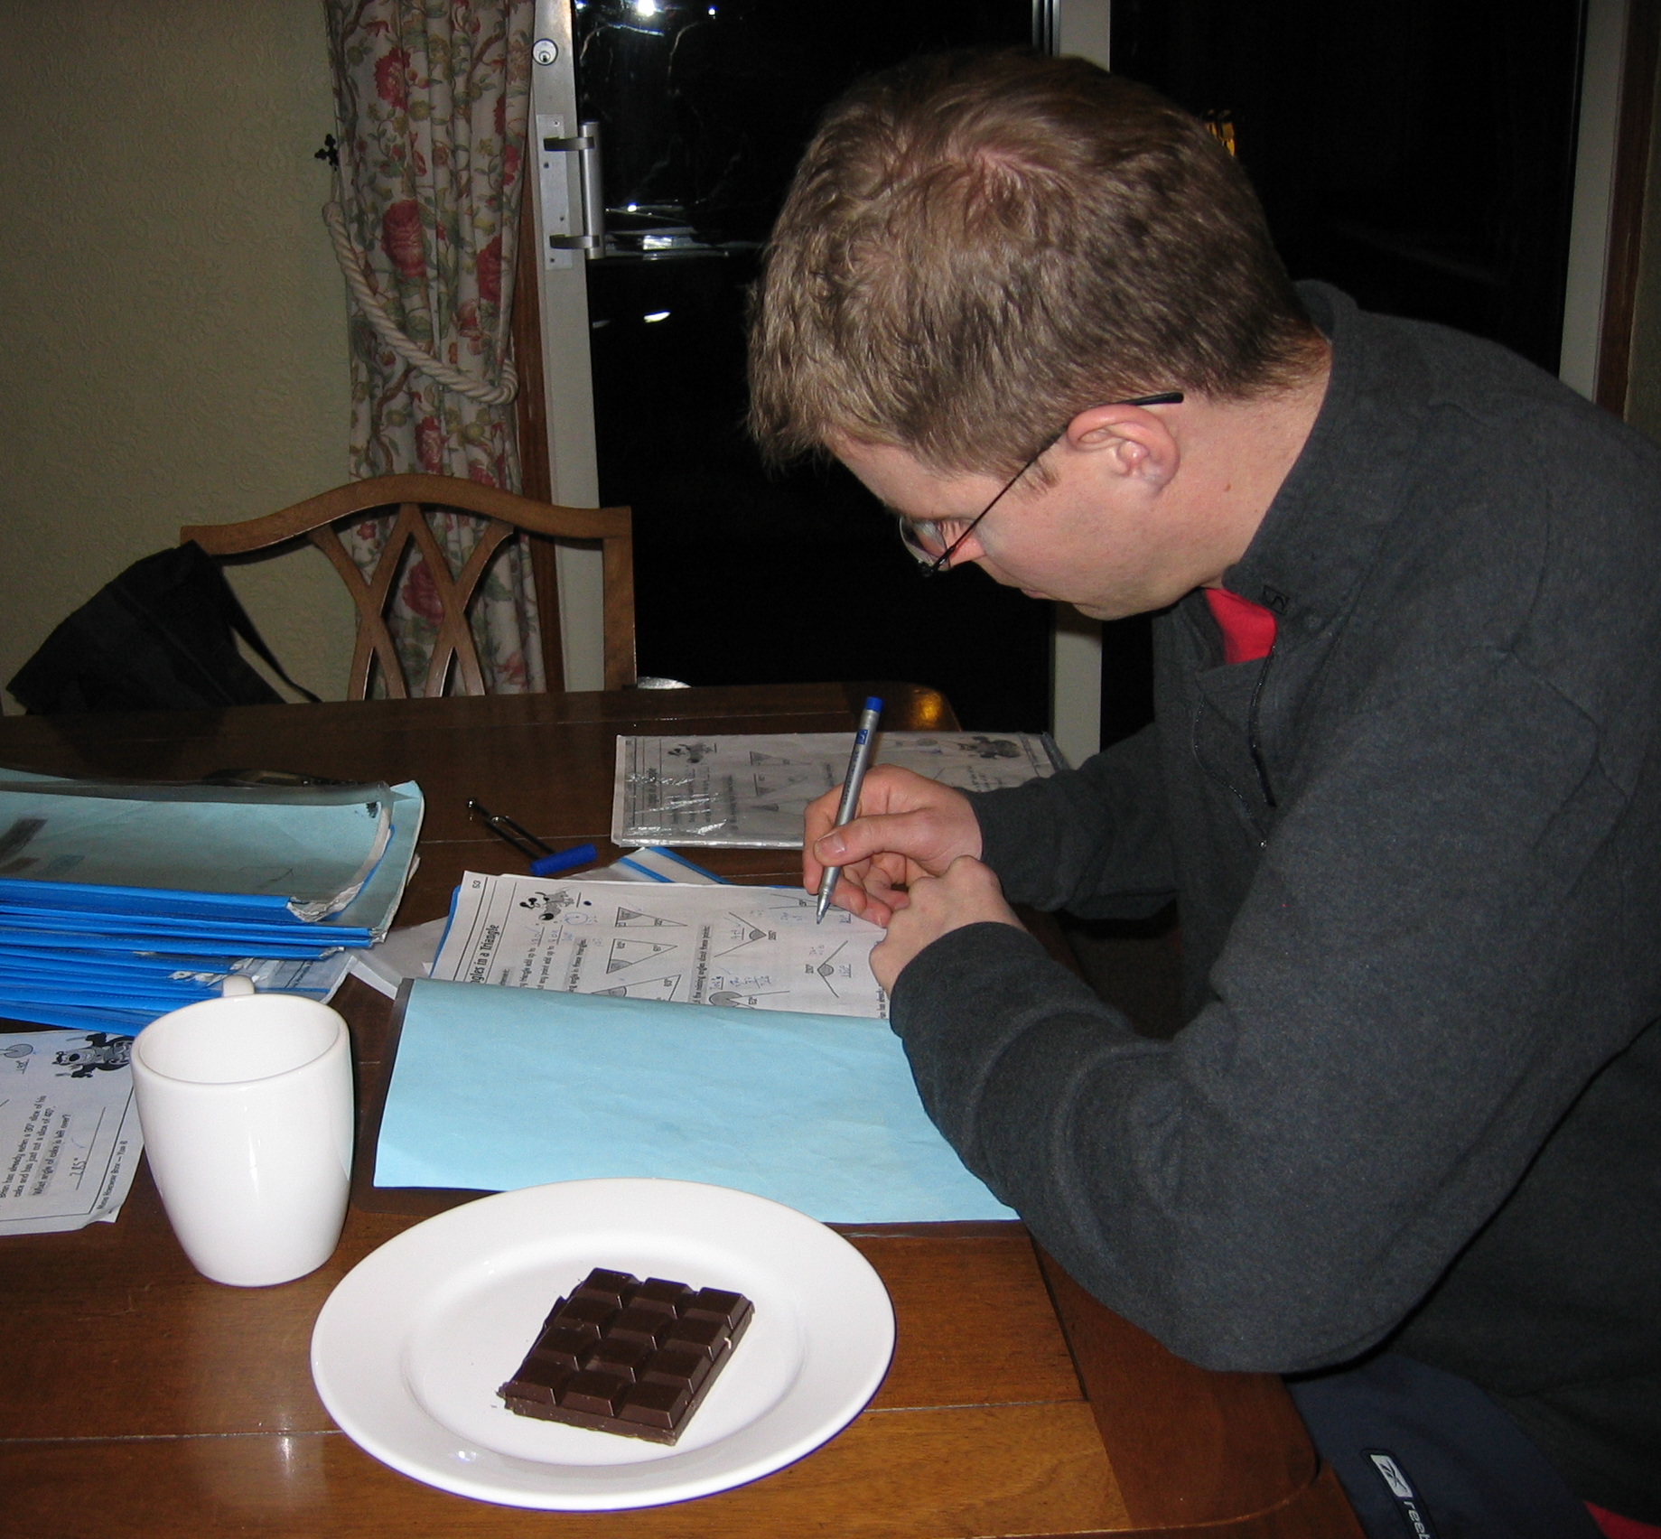
Cause and effect
Discuss these headlines.
“Taller students do better in new Maths test!”
“The more coffee you drink, the more stressed you are.”
“Chocolate causes lower grades at university.”
“Counselling can make you depressed.”
“New exercise regime causes dramatic rise in injuries at local hospital.”
Notes:
These are examples of fallacious cause and effect statements. Discuss alternative reasons/ causes.
Age is the cause: the older you are, the taller you are likely to be and the better you are in tests (up to a certain age!).
You could be drinking coffee because you are stressed, not the other way round.
You could be eating too much chocolate because you are stressed/ depressed/ not coping with your work/ getting bad grades.
People who go for counselling are often depressed anyway, so a sample of people who have been counselled is likely to be biased.
People who are unfit may be using the exercise regime and so are more likely to injure themselves.

